Slide 1
Path planning with moving obstacles
-Akash Sasikumar
-Gail Renee Pinto

Slide 2
Problem Description
It is essential for a robot configuration to be able to plan a path to the goal location from the start or current location.
Difficult to plan a path in an environment with moving obstacles.
Robot will need to be able to dynamically determine a course of action in order to avoid a collision

Slide 3
Algorithms
RRT*
RRT* with moving obstacle
Dynamic RRT

Slide 4
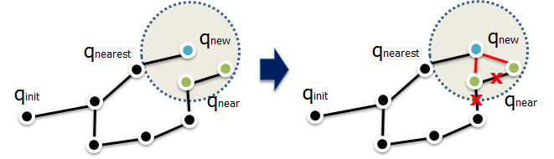
RRT*
Variant of RRT that converges towards an optimal solution.
In RRT* we perform optimization through the process of rewiring nodes.
Image Source

Slide 5
RRT* in Action

Slide 6
RRT* with moving obstacle in Action

Slide 7
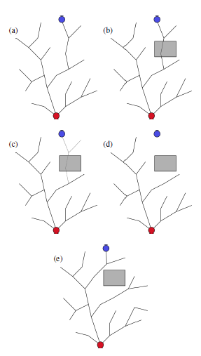
Dynamic RRT
Instead of abandoning the entire tree, this algorithm efficiently removes just the newly-invalid parts and maintains the rest of the tree.
It then grows the resulting tree until a new solution to the goal is found.
Image source

Slide 8
Dynamic RRT

Slide 9

Thank You

